Slide 1


M TT Pr t c l

Slide 2





MQTT & it's Components
Applications of MQTT
Advantage/Disadvantage
Architecture of MQTT
HTTP vs MQTT
Brokers/Mosquitto brokers

Slide 3


MQTT
MQTT is a machine-to-machine (M2M)/"Internet of Things" connectivity protocol.
MQTT stands for Message Queuing Telemetry Transport.
Extremely lightweight publish/subscribe messaging transport.
Its small size, low power usage, minimized data packets
Minimize network bandwidth and device resource requirements whilst also attempting to ensure reliability and some degree of assurance of delivery.
Ideal for M2M and IOT
Runs on connection-oriented transport (TCP)

Slide 4


MQTT Components:
Broker, which is the server that handles the data transmission between the clients.
A topic, which is the place a device want to put or retrieve a message to/from.
The message, which is the data that a device receives “when subscribing” from a topic or send “when publishing” to a topic.
Publish, is the process a device does to send its message to the broker.
Subscribe, where a device does to retrieve a message from the broker.

Slide 5

Applications
Facebook currently uses MQTT for its Messenger app,
Major cloud services providers, including Amazon Web Services (AWS), Google Cloud, IBM Cloud and Microsoft Azure support MQTT.
Real-time analytics, preventative maintenance and monitoring in environments, including smart homes, healthcare, logistics, industry and manufacturing.

Slide 6

Advantage
Efficient data transmission and quick to implement due to its being a lightweight protocol
Low network usage, due to minimized data packets;
Efficient distribution of data
Fast and efficient message delivery
Successful implementation of remote sensing and control
Usage of small amounts of power, which is good for the connected devices
Reduction of network bandwidth

Slide 7

Disadvantage
MQTT has slower transmit cycles compared to CoAP.
MQTT's resource discovery works on flexible topic subscription, whereas CoAP uses a stable resource discovery system.
MQTT is unencrypted. Instead, it uses TLS/SSL for security encryption.
It is difficult to create a globally scalable MQTT network.

Slide 8
How MQTT Server/Broker Works
An MQTT system consists of multiple clients—publishers or subscribers—that are configured to communicate with a server, also known as a broker. There are four primary MQTT Control Packets that a client and server can use to communicate:
Connect—The first packet sent from the client to the server must be a Connect packet in order to establish a connection.
Disconnect—The final packet sent from the client to the server that indicates why the connection is being closed.
Subscribe—A subscribe packet is always sent from the client to the server to create one or more topic subscriptions.
Publish—A publish packet can be sent from the client to the server, usually transporting an application message, or from the server to a client which has subscribed to the respective topic.

Slide 9
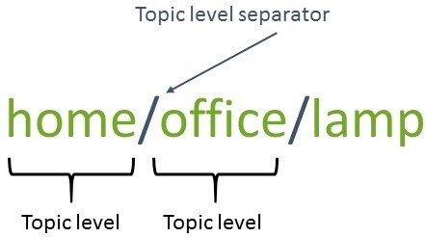
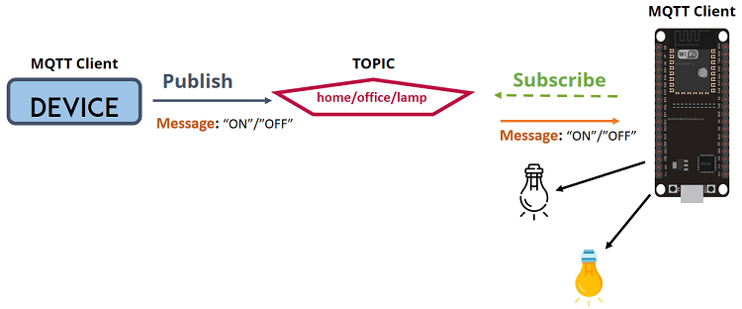

MQTT – Topics
For inquiries and concerns
Topics are the way you register interest for incoming messages or how you specify where you want to publish the message.
For inquiries and concerns
You have a device that publishes “on” and “off” messages on the home/office/lamp topic.
You have a device that controls a lamp (it can be an ESP32, ESP8266, or any other board). The ESP32 that controls your lamp, is subscribed to that topic: home/office/lamp.
So, when a new message is published on that topic, the ESP32 receives the “on” or “off” message and turns the lamp on or off.

Slide 10








Architecture
Publisher
Broker
Subscriber 1
Subscriber 2
Subscriber 3

Slide 11





Architecture
topic selected home/lamp
“on” or “off” message
MQTT Broker
“on” or “off” message
home/ac
home/tv
home/lamp

Slide 12
Publisher-subscriber relationships
Publisher-subscriber relationships
For inquiries and concerns
For inquiries and concerns
Subscriber
Publisher
Subscriber
Publisher
subscribed to Topic 1
subscribed to Topic 1
Broker
Broker
sensor
sensor
Topic 1
Topic 1
Subscriber
Subscriber
Publisher
Publisher
subscribed to Topic 2
Topic 2
subscribed to Topic 2
Topic 2
sensor
sensor
Subscriber
Subscriber
Publisher
Publisher
subscribed to Topic 1
subscribed to Topic 1
dashboard
dashboard

Slide 13
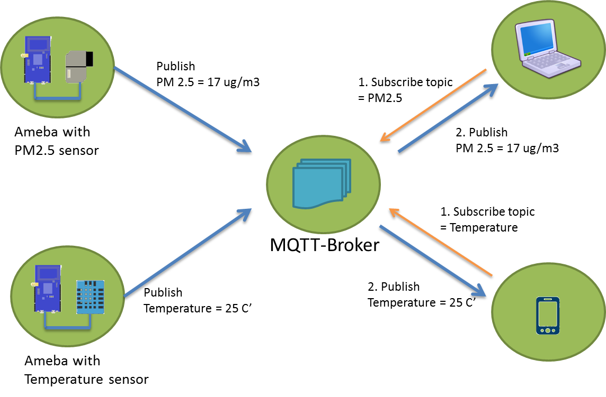

Slide 14
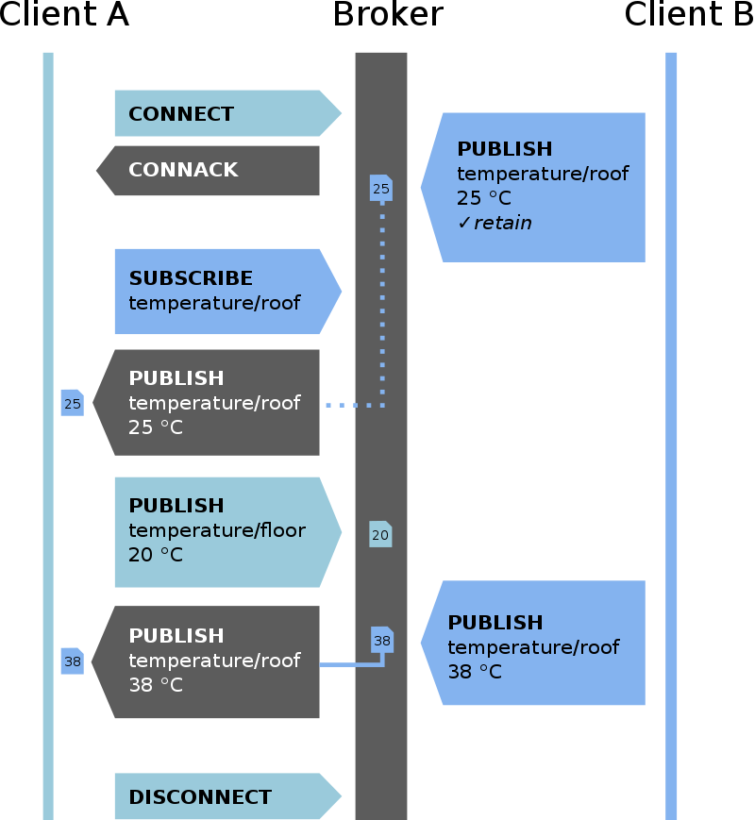

Slide 15

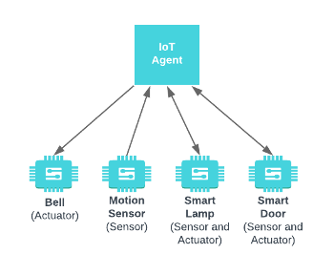
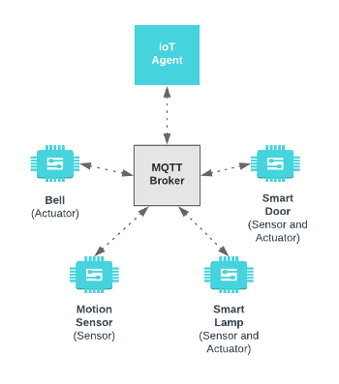
MQTT HTTP
HTTP Transport
MQTT Transport

Slide 16
MQTT HTTP
HTTP Transport
MQTT Transport
IoT Agent communicates with IoT devices directly
IoT Agent communicates with IoT devices indirectly via an MQTT Broker
Request-Response Paradigm
Publish-Subscribe Paradigm
IoT Devices must always be ready to receive communication
IoT Devices choose when to receive communication
Higher Power Requirement
Low Power Requirement

Slide 17

Why we use MQTT instead of HTTP
According to measurements in 3G networks, throughput of MQTT is 93 times faster than HTTP’s.
MQTT Protocol ensures high delivery guarantees. There are 3 levels of Quality of service (QoS)
MQTT has pretty short specification. There are only CONNECT, PUBLISH, SUBSCRIBE, UNSUBSCRIBE and DISCONNECT types that are significant for developers. Whereas HTTP specifications are much longer.
MQTT has a very short message header and the smallest packet message size of 2 bytes. Using text message format by HTTP protocol allows it to compose lengthy headers and messages.
HTTP is worthy and extendable. But MQTT is more suitable when it is referred to IoT development.
MQTT is highly scalable.

Slide 18

MQTT Brokers
Broker is the heart of any publish/subscribe protocol.
The broker is primarily responsible for receiving all messages, filtering the messages, decide who is interested in them and then publishing the message to all subscribed clients.
Authentication and authorization of clients
Well known MQTT Brokers:
Mosquitto
flespi
HiveMQ
mosca

Slide 19
Mosquitto Brokers
Lightweight open source broker written in C. Probably the most popular MQTT broker. Supports MQTT v3.1.1 and v5
available as a free download for Windows and Linux and is an Eclipse project.
Installing Mosquitto is straightforward on most systems including the Raspberry Pi under Raspbian

Slide 20
